Slide 1

Deep Learning
Introduction to Deep Learning
CSE Department
National Institute of Technology Rourkela

Slide 2
References:
The Slides are prepared from the following major sources:
“CS7105-Deep Learning” by Mitesh M. Khapra, IIT Madras. http://www.cse.iitm.ac.in/~miteshk/CS7015_2018.html
Jürgen Schmidhuber. Deep learning in neural networks: An overview. Neural Networks, 61:85–117, 2015.

Slide 3
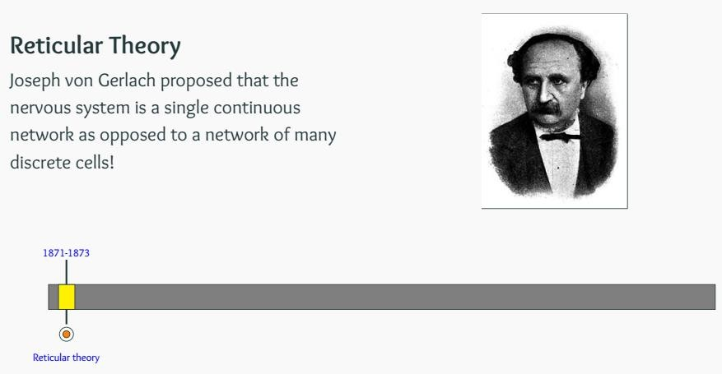
Biological Neurons

Slide 4
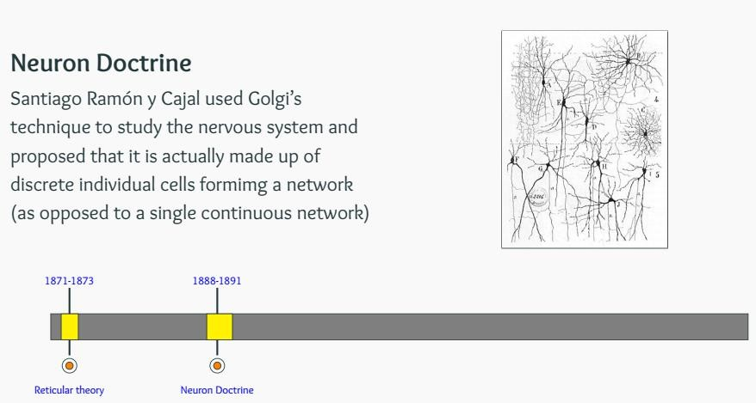
Biological Neurons

Slide 5
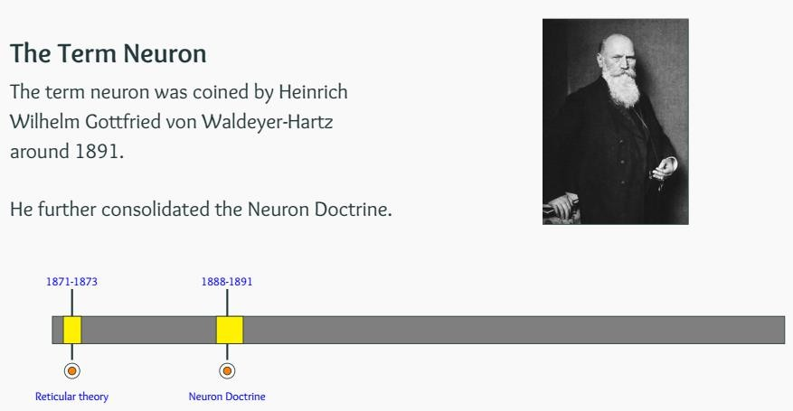
Biological Neurons
Same person also coined the termed chromosome

Slide 6
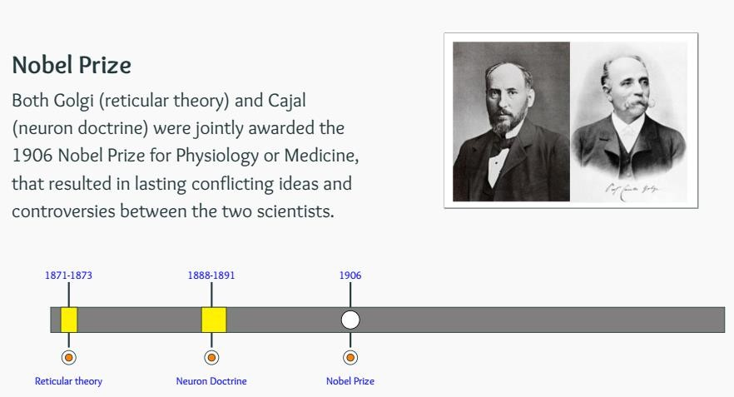
Biological Neurons

Slide 7
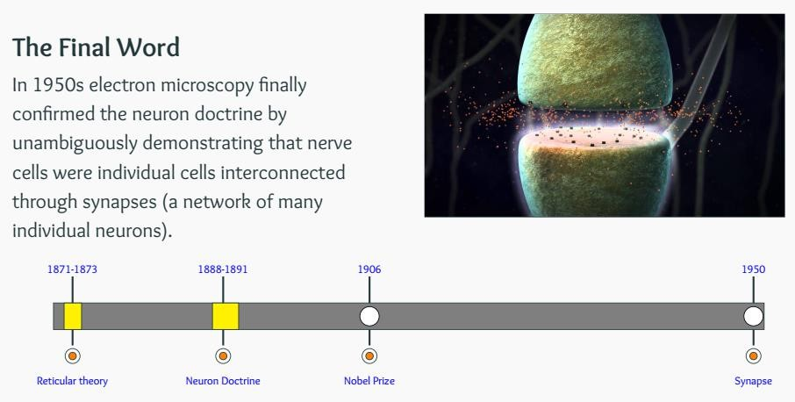
Biological Neurons

Slide 8
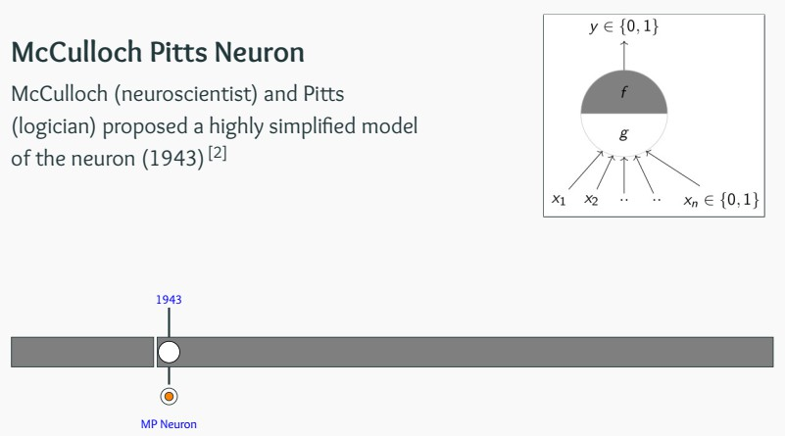
From Spring to Winter of AI
In the history of AI, the dominant narrative swings back and
forth between periods of “spring” and “winter”:
First Spring (1956–1974),
Second Spring (1981–1987)
First Winter (1974–1981)
Second Winter (1987–1993)

Slide 9
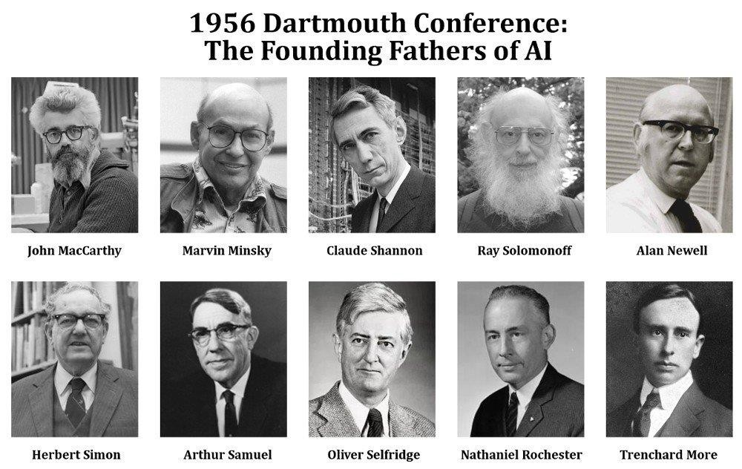
Dartmouth conference: 1956
“Artificial Intelligence” term was coined
Courtesy of scienceabc.com

Slide 10
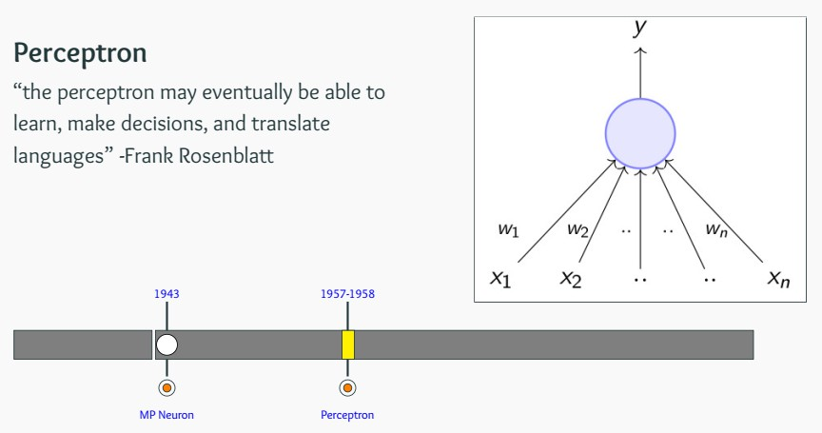
From Spring to Winter of AI

Slide 11
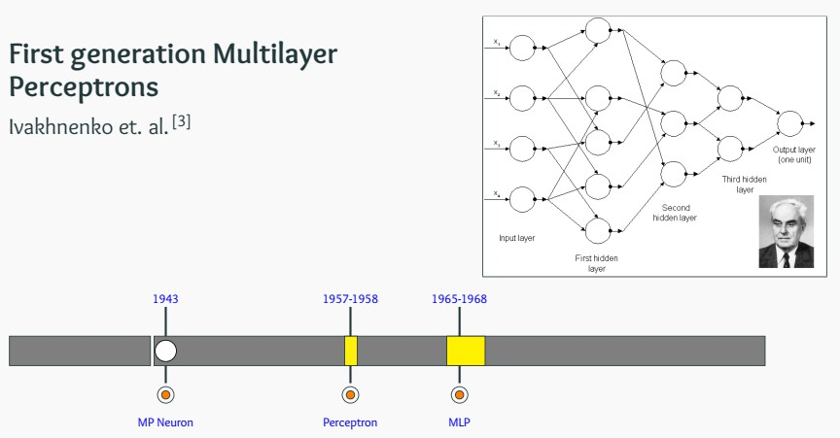
From Spring to Winter of AI

Slide 12
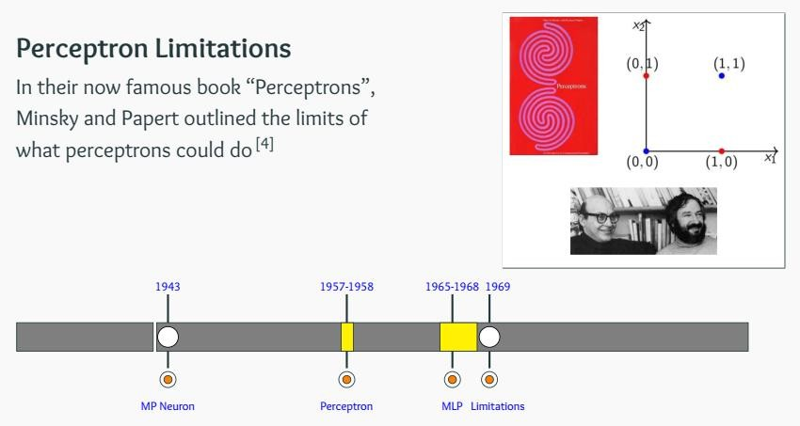
From Spring to Winter of AI

Slide 13
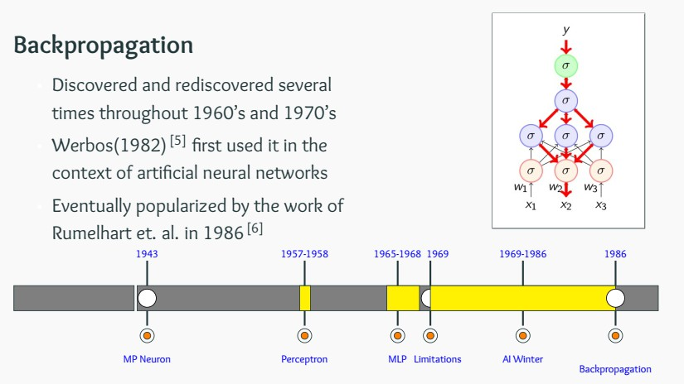
From Spring to Winter of AI

Slide 14
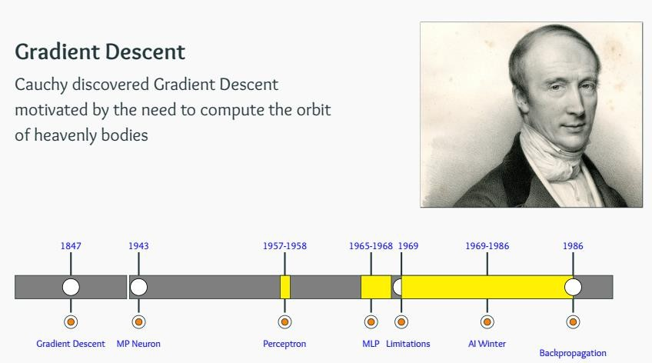
From Spring to Winter of AI

Slide 15
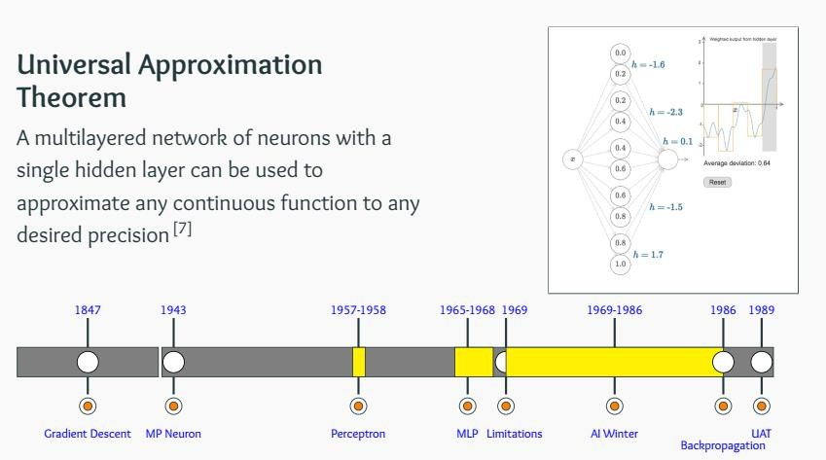
From Spring to Winter of AI

Slide 16
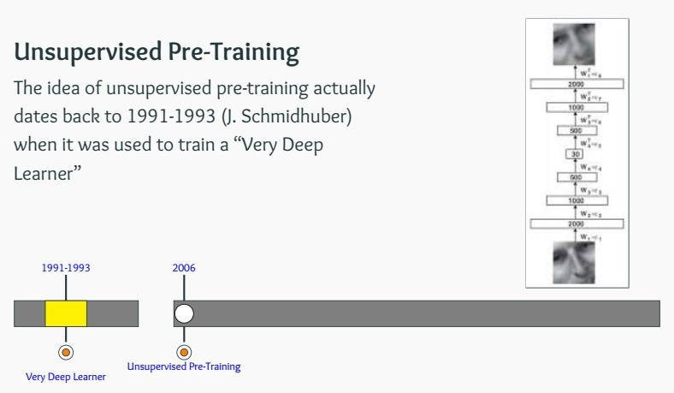
The Deep Revival

Slide 17
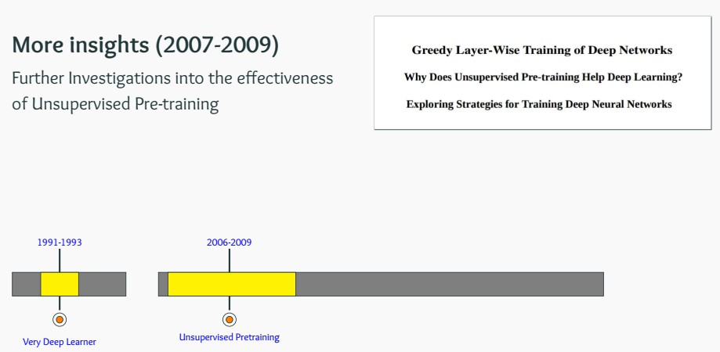
The Deep Revival

Slide 18
Cats to CNN

Slide 19
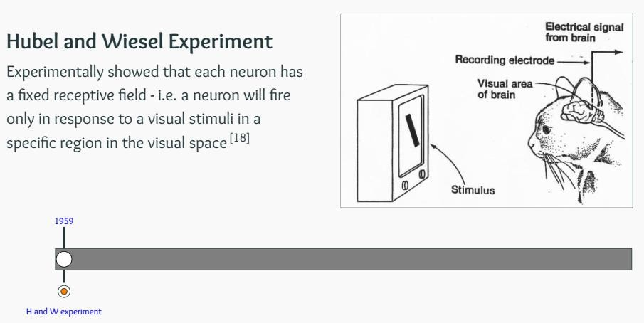
From Cats to Convolutional Neural Nets

Slide 20
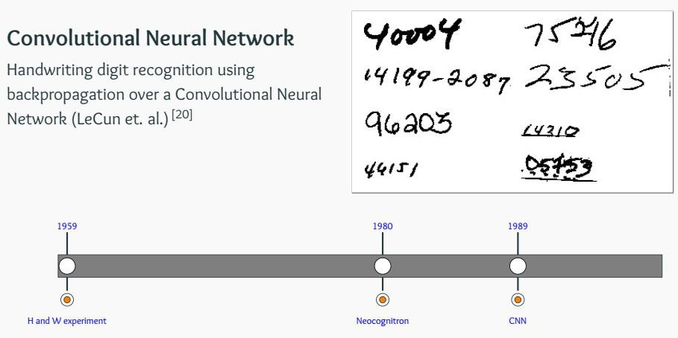
From Cats to Convolutional Neural Nets

Slide 21
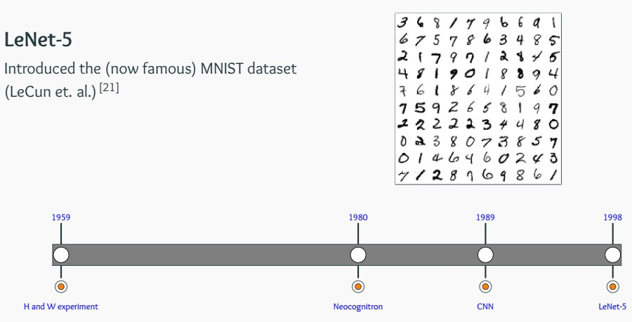
From Cats to Convolutional Neural Nets

Slide 22
CNN for Computer Vision

Slide 23
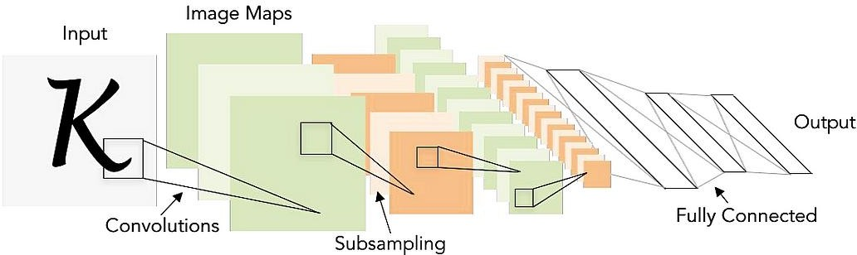
Next level understanding
The name convolutional neural networks actually originated with
the design of the LeNet by Yann LeCun and team, 1998.
It was largely developed for the handwritten digit recognition task.
LeCun, Y., Bottou, L., Bengio, Y. and Haffner, P., 1998. Gradient-based learning applied to document recognition. Proceedings of the IEEE, 86(11), pp.2278–2324

Slide 24
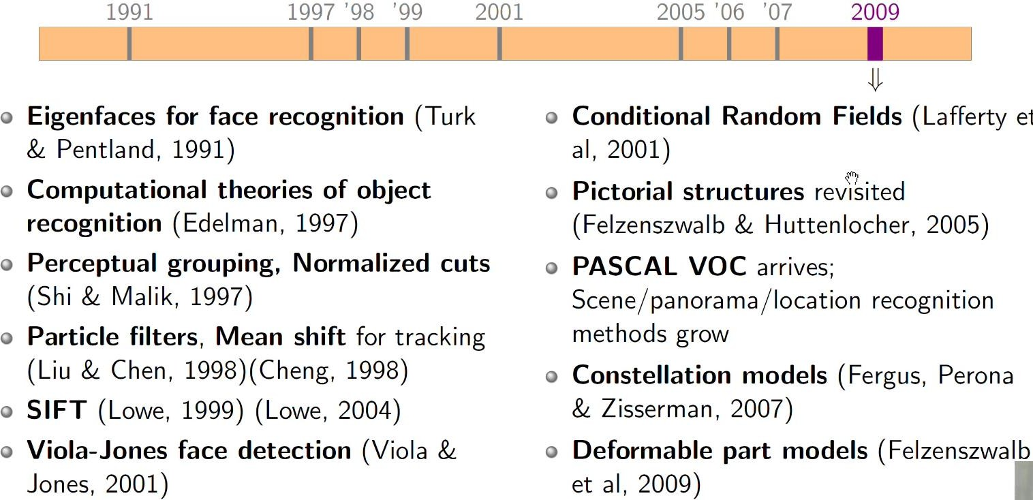
Next level understanding

Slide 25
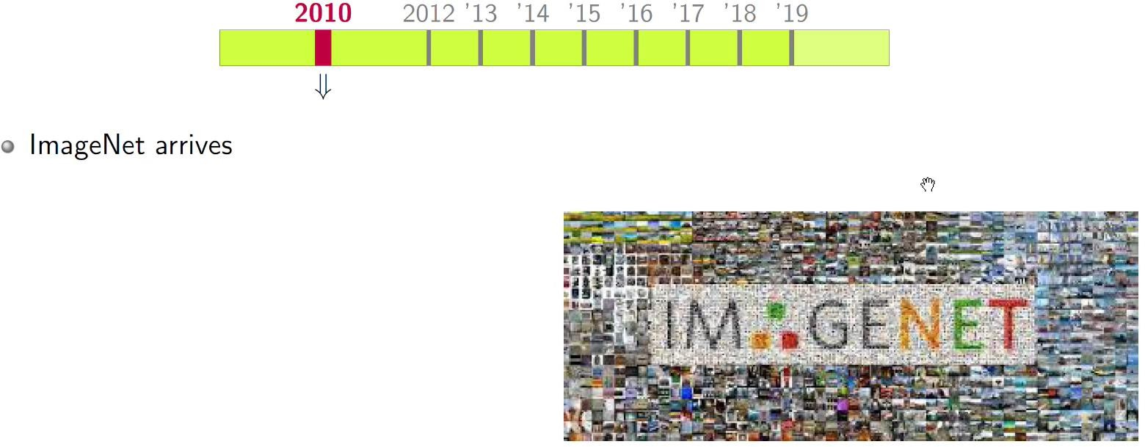
Next level understanding
ImageNet large scale visual recognition challenge (ILSVRC)
The validation and test data for this competition will consist of 200,000 photographs
collected from flickr and other search engines
hand labeled with the presence or absence of 1000 object categories.
https://image-net.org/challenges/LSVRC/2010/#introduction

Slide 26
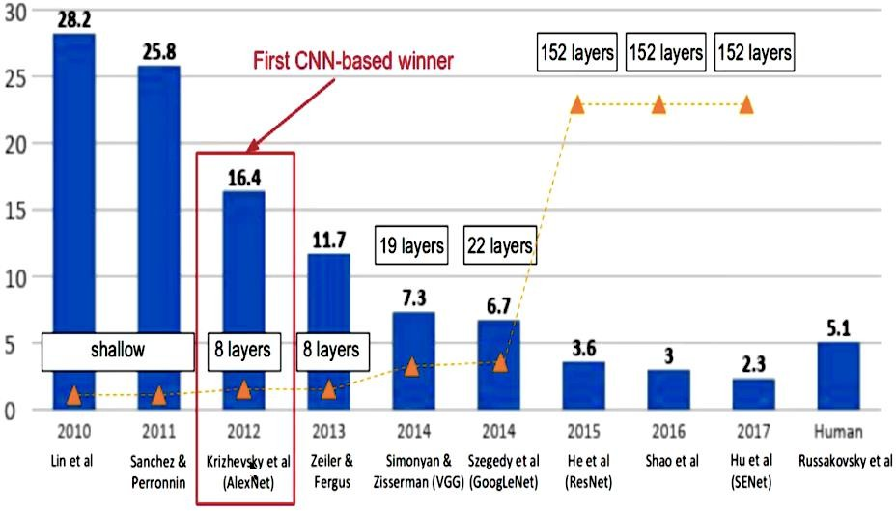
Next level understanding: 2015
https://medium.com/appyhigh-technology-blog/convolutional-neural-networks-a-brief-history-of-their-evolution-ee3405568597

Slide 27
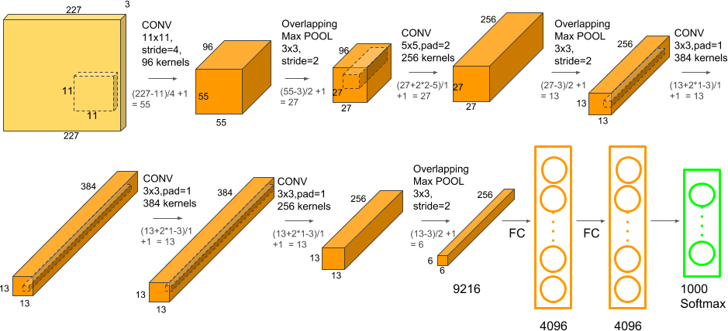
Next level understanding: 2012
AlexNet (Alex Krizhevsky and Geoffrey Hinton, 2012) winds the
ImageNet challenge
Before 2012, networks were shallow
Krizhevsky, A., Sutskever, I. and Hinton, G.E., 2017. ImageNet classification with deep convolutional neural networks. Communications of the ACM, 60(6), pp.84–90.

Slide 28
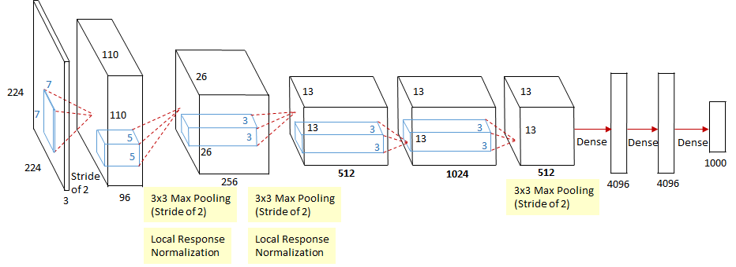
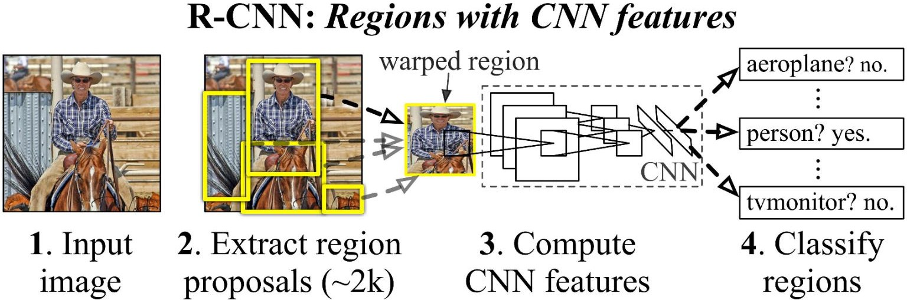
Next level understanding: 2013
ZFNet: Matthew D Zeiler and Rob Fergus (ILSVRC 2013)

Slide 29
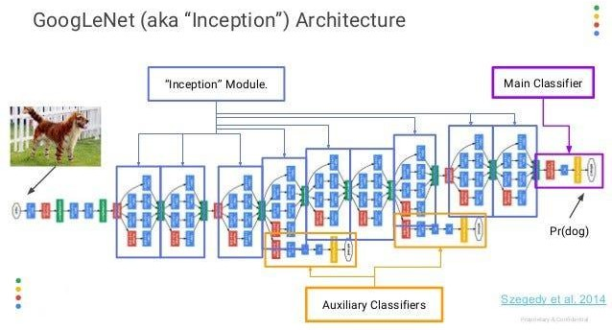
Next level understanding: 2014
InceptionNet

Slide 30
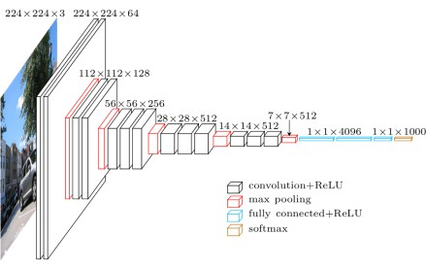
Next level understanding: 2014
VGG :invented by Visual Geometry Group (at Oxford University)

Slide 31
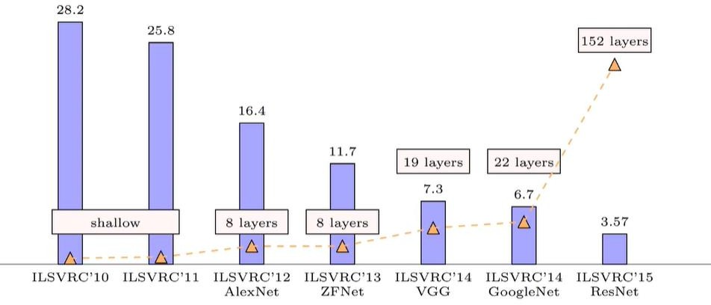
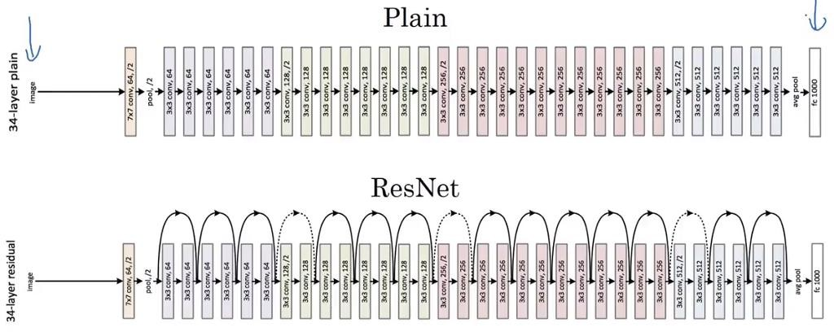
Next level understanding: 2015
ResNet: Kaiming He et. al. from Microsoft Research
CNN somewhat matched
human performance

Slide 32
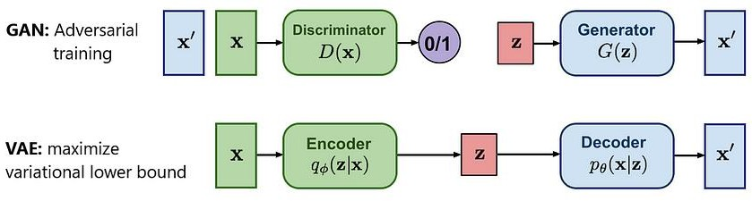
Next level understanding: 2014
Deep generative models: GANs, VAEs

Slide 33
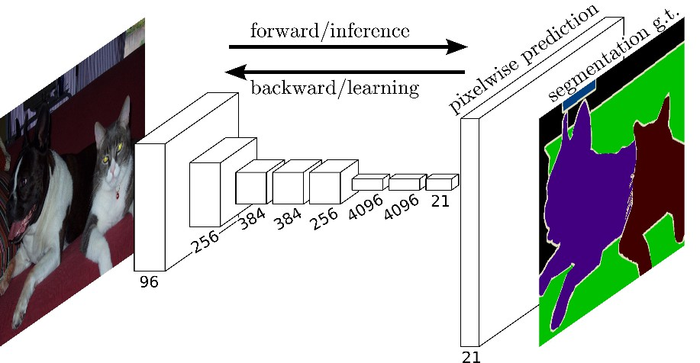
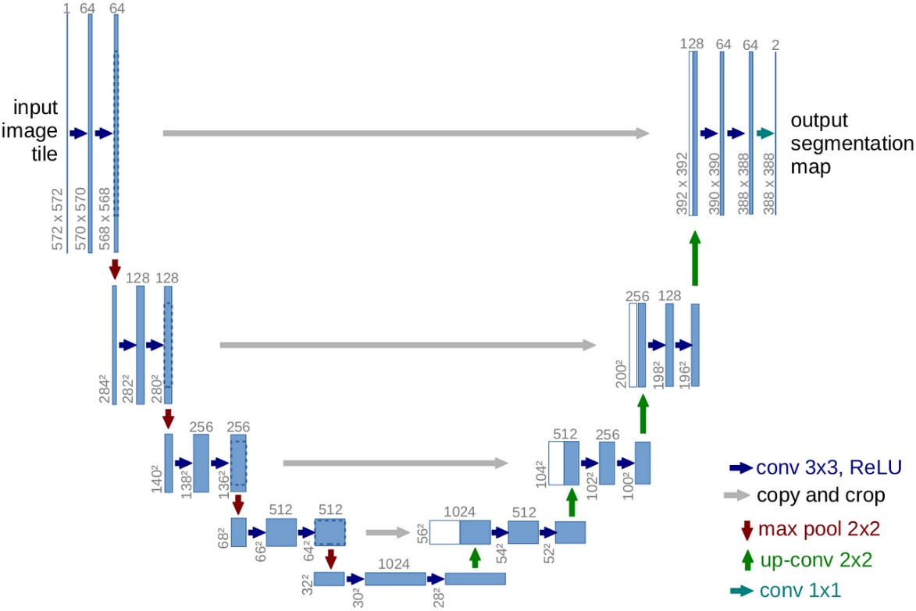
Next level understanding: 2015
Segmentation networks: FCN, SegNet and U-Net for semantic
segmentation; COCO dataset arrives; VQA dataset arrives

Slide 34
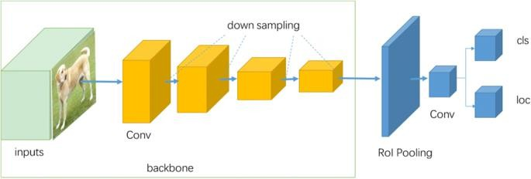
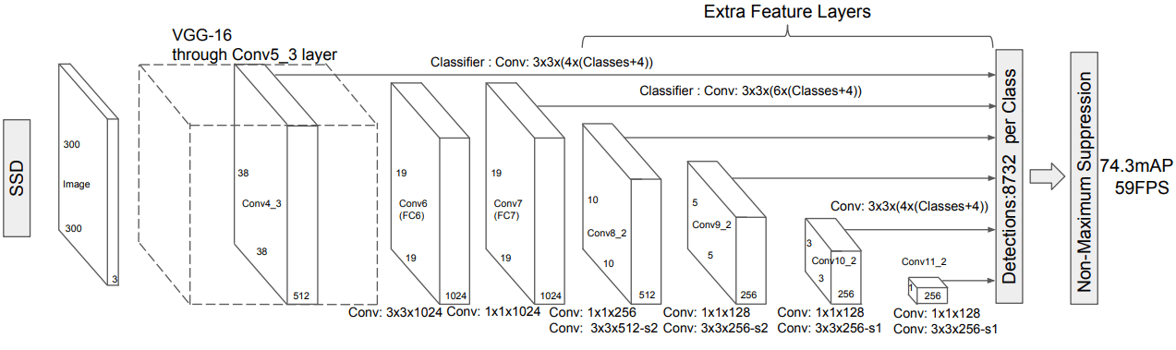
Next level understanding: 2016
YOLO and SSD for object detection;
Cityscapes dataset arrives, Visual Genome dataset arrives

Slide 35
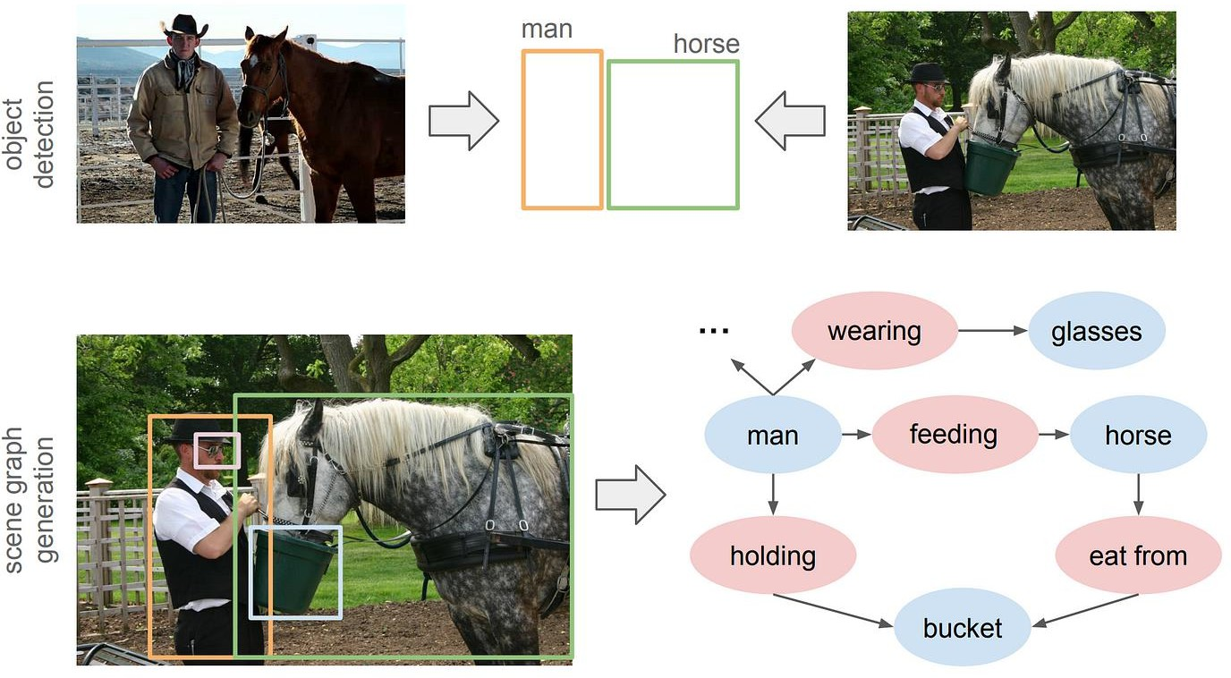
Next level understanding: 2017
Scene Graph Generation model

Slide 36
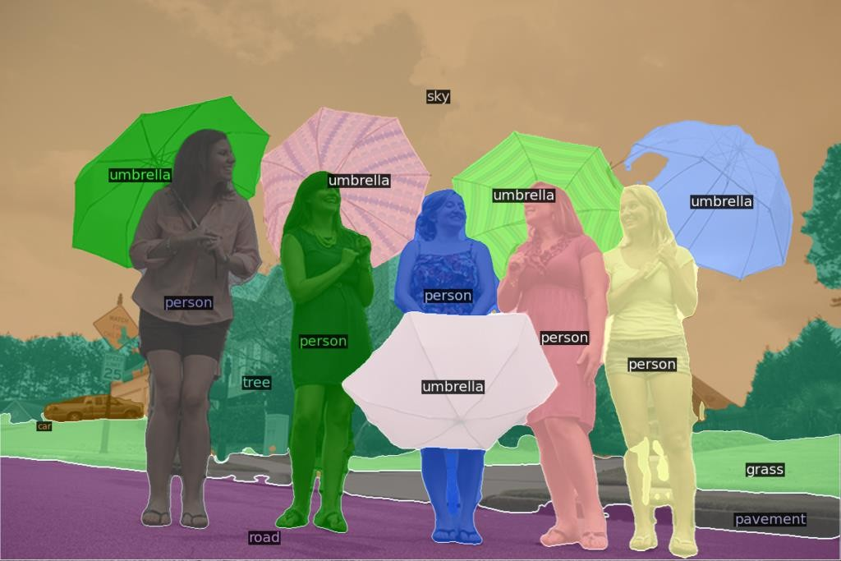
Next level understanding: 2018, 2019
VCR (Visual Common sense Reasoning) dataset
Panoptic segmentation

Slide 37
Faster …. Better….

Slide 38
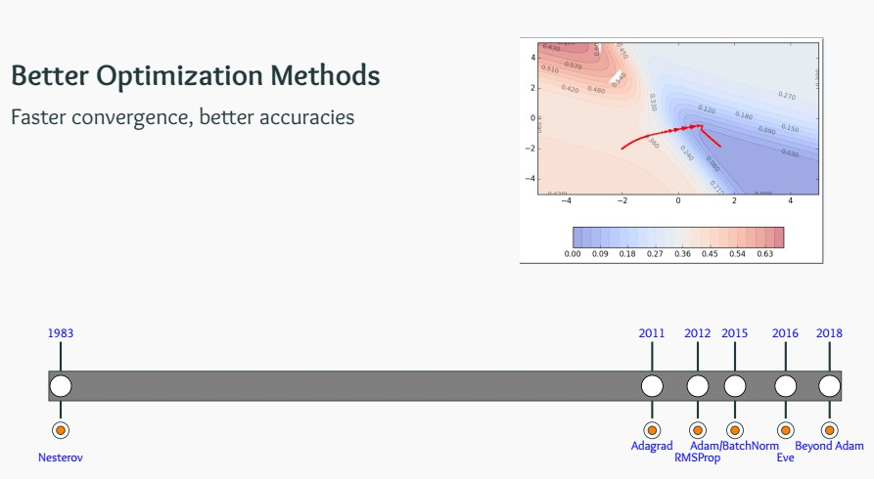
Better Optimization Methods
Faster convergence, Higher accuracy, Stronger

Slide 39
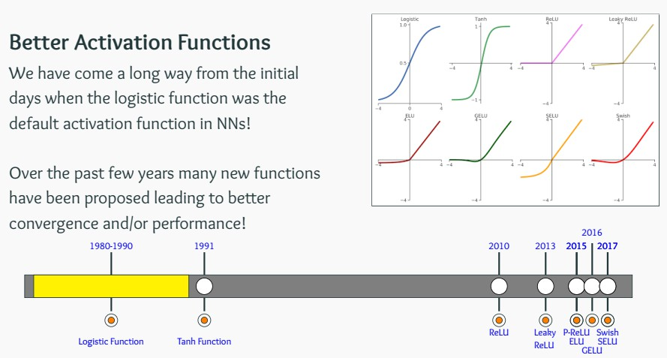
Better Activation Functions

Slide 40
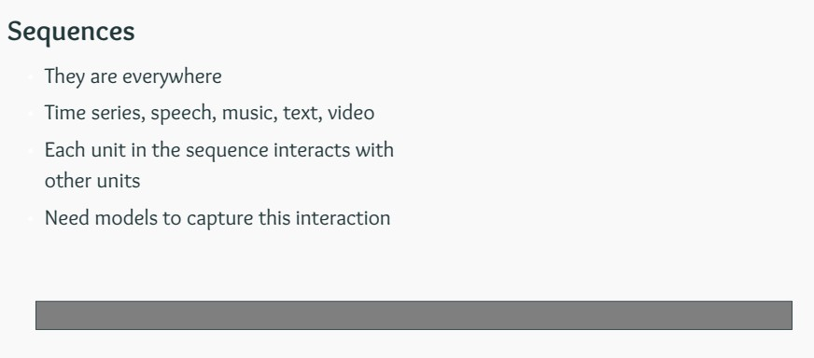
Sequences

Slide 41
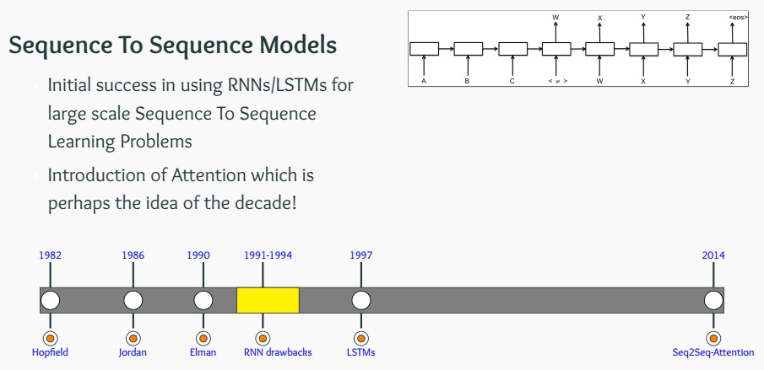
Sequences

Slide 42
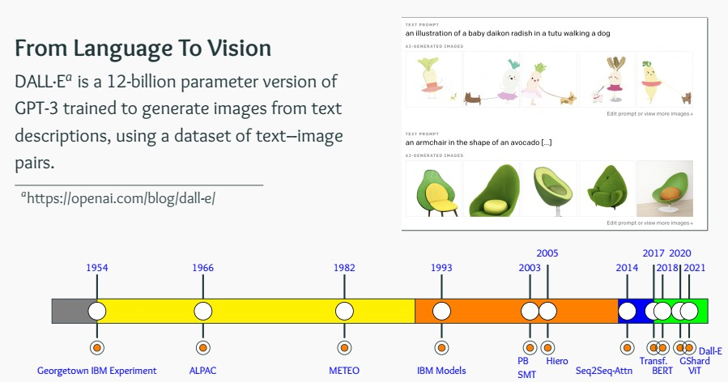
The Rise of Transformers

Slide 43
Explainable AI

Slide 44
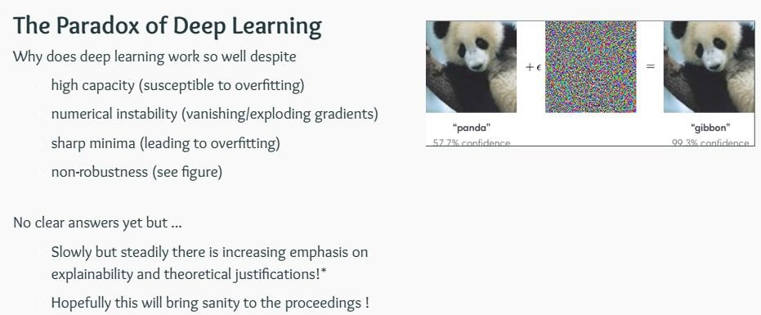
Interpretable, Responsible & Green AI

Slide 45
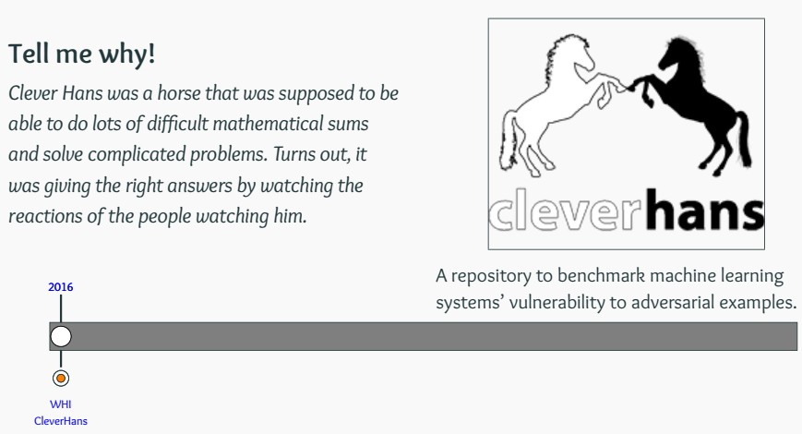
Interpretable, Responsible & Green AI

Slide 46
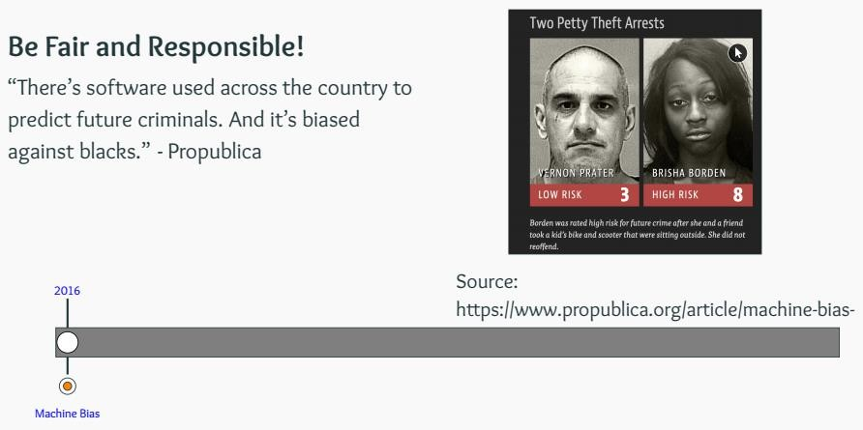
Interpretable, Responsible & Green AI

Slide 47
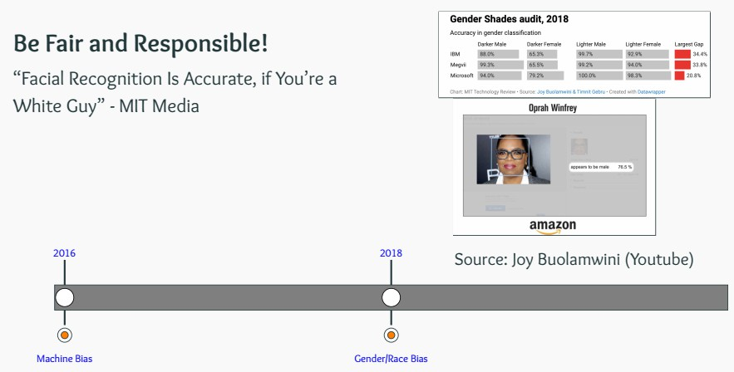
Interpretable, Responsible & Green AI

Slide 48
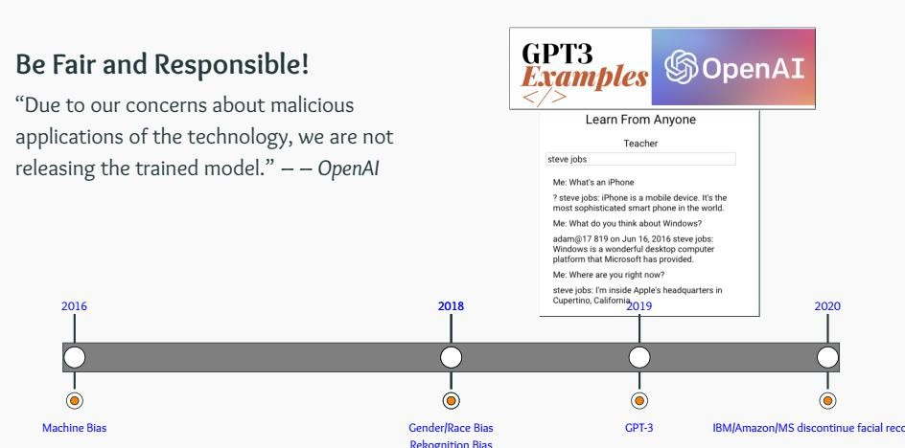
Interpretable, Responsible & Green AI

Slide 49
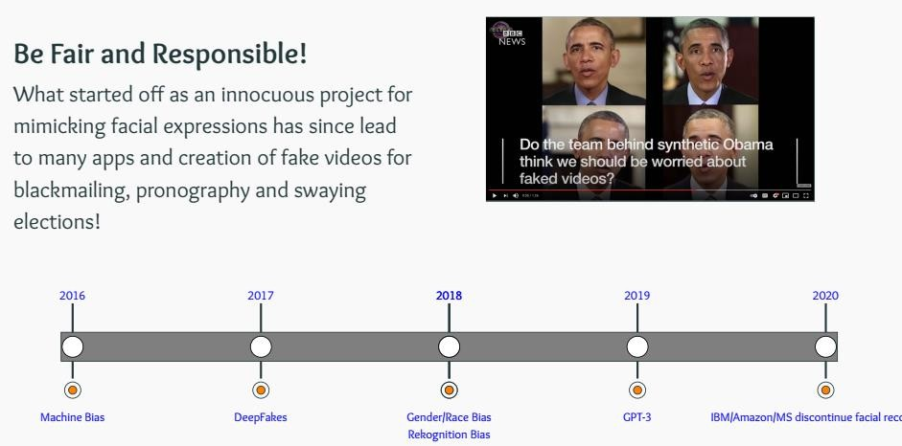
Interpretable, Responsible & Green AI

Slide 50
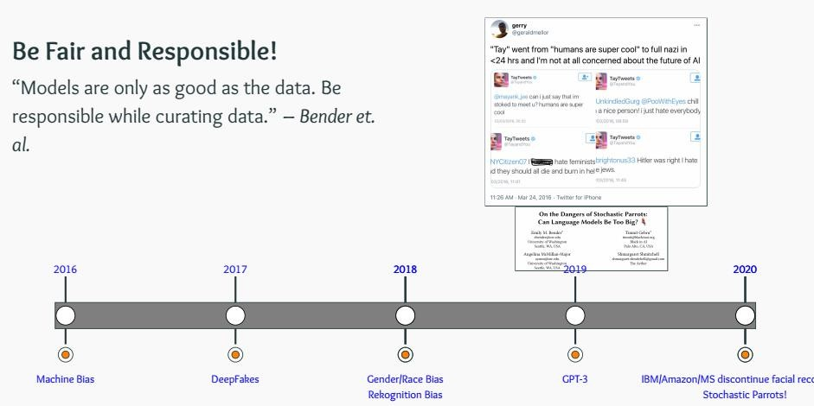
Interpretable, Responsible & Green AI

Slide 51
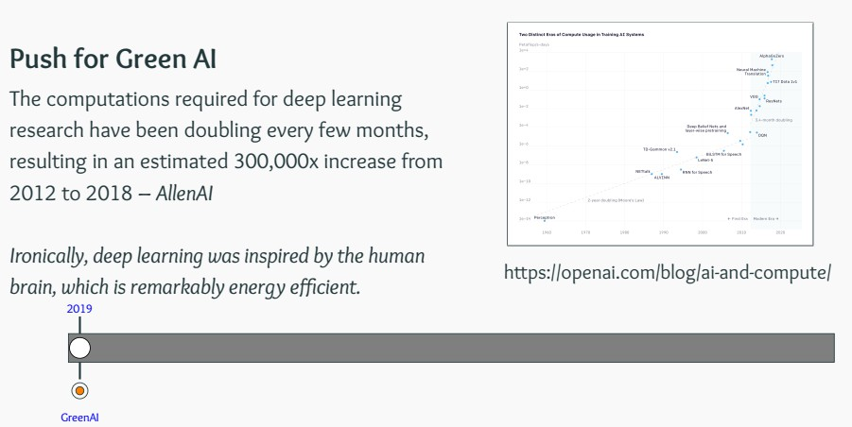
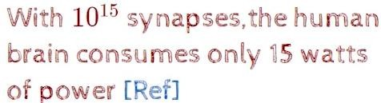
Interpretable, Responsible & Green AI

Slide 52


Interpretable, Responsible & Green AI

Slide 53

Interpretable, Responsible & Green AI

Slide 54

AI Revolutionize Scientific Research
Source: https://www.cbinsights.com/research/artificial-intelligence-top-startups/

Slide 55
End of topic

